Slide 1


Presentation on: Academic Project proposal
A research based project…..
Notes:
NOTE:
To change the image on this slide, select the picture and delete it. Then click the Pictures icon in the placeholder to insert your own image.

Slide 2

Presented by-
M. A. Nur Quraishi
Roll: BSSE-0615
BSSE 6th Batch
IIT, DU
Supervised by-
Rayhanur Rahman
Lecturer at
IIT, DU

Slide 3
Project Name
Recovering Documentation to Source Code Traceability Links using Latent Semantic Indexing (RDSCTL)

Slide 4
Contents
Introduction
Motivations for the Research
Assumptions
Problem Statements
Why RDSCTL is better?
Research Methodologies
Project Timeline
References
Question Session

Slide 5
Introduction
Going to implement an existing work or method (upscale it if possible)
Previously analyzed by Andrian Marcus and Jonathan I. Maletic from Department of Computer Science, Kent State University, Kent Ohio
an information retrieval (IR) mechanism
Latent Semantic Indexing (LSI) is used to automatically generate or identify the traceability links from system documentation to program source code
Latent Semantic Indexing (LSI):
Vector Space Model (VSM) based method
for generating and representing aspects of the meanings of words and passages reflective in their usage
used in natural language processing (NLP)
information about word contexts in which a particular word appears, or does not appear, provides a set of mutual constraints that determines the similarity of meaning of sets of words to each other

Slide 6
Motivations for the Research
The whole software engineering community desperately working to find out the explicit connection between documentation and source code
Identifying traceability link in a legacy system important for various software engineering tasks-
general maintenance tasks
impact analysis
program comprehension
reverse engineering for redevelopment
systematic reuse
Industrial Purpose:
client can measure satisfaction rate by comparing requirements and the product (source code) in hand
Academic Purpose:
teacher can measure actual implementation rate that students promised in their SRS
teacher can identify which feature is missing from the source code or application

Slide 7
Assumptions
The comments and identifiers are reasonably named
Developers use the same natural language (e.g., English, Romanian, etc.) in writing internal documentation (source code) and external documentation (SRS)

Slide 8
Problem Statements
Using Information Retrieval (IR) methods to support software engineering tasks
Recovering source code to documentation links

Slide 9
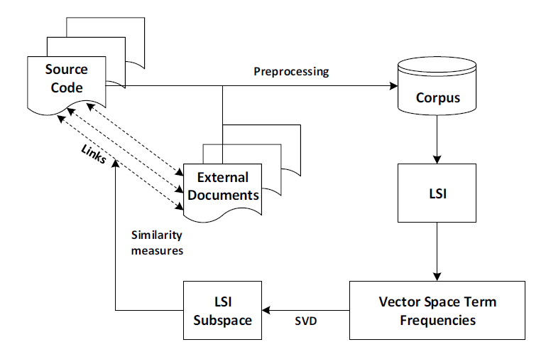
Problem Statements (Continued)

Slide 10
Why RDSCTL is better?
Does not rely on predefined vocabulary or grammar for the documentations or source code
For example, having "automobile" in one document and "car" in another document does not contribute to the similarity measure between these two documents
Not required large number of preprocessing or manipulation of the input
Drastically reduces the cost and time of link recovery

Slide 11
Research Methodologies
Step No. | Title of Activity | Activity description
1. | Literature Survey | Building the background for the research. This will be a continuous task Writing research proposal
2. | Study Existing Recovering Traceability Links Frameworks | Intensifying the focus on more specific area This task will cover the similar or related works to our area of interest exhaustively Reporting on survey
3. | Implementing the research work | The framework will be generated here
4 | Case Study and Comparison with other Existing Work | Studying existing frameworks to identify the required structure for Recovering Traceability Links Evaluating the framework against other existing ones Producing a Technical report on the findings
5. | Technical Report Writing | At the end, one technical report will be published

Slide 12
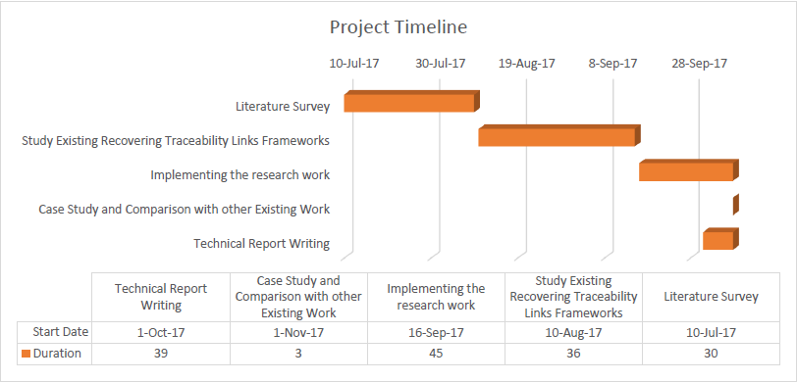
Project Timeline

Slide 13
References
Andrian Marcus, Jonathan I. Maletic, “Recovering Documentation-to-Source-Code Traceability Links using Latent Semantic Indexing”
Deerwester, S., Dumais, S. T., Furnas, G. W., Landauer, T. K., and Harshman, R., "Indexing by Latent Semantic Analysis", Journal of the American Society for Information Science, 41, 1990, pp. 391-407.
Dumais, S. T., "Improving the retrieval of information from external sources", Behavior Research Methods, Instruments, and Computers, 23, 2, 1991, pp. 229 - 236.

Slide 14

Question Session

Slide 15
Thank You!!!

